Slide 1

Statistical programming in
Nosotros aprenderemos un nuevo idioma

Slide 2

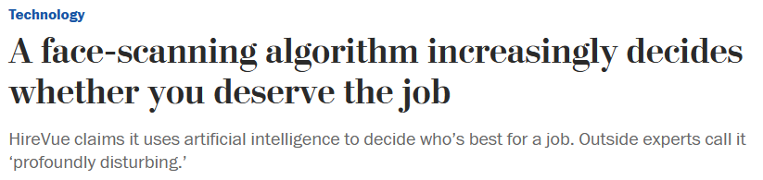
Key skills to become a good scientist
“Yeah, but your [programmers] were so preoccupied with whether or not they could, they didn’t stop to think if they should”
- Dr Ian Malcolm (1993)
In order of importance
Biological/scientific understanding
Statistical understanding
Many other things…
Programming ability
Victorian pseudo-science
Focussing on coding skills, leads to…

Slide 3
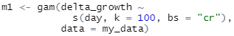
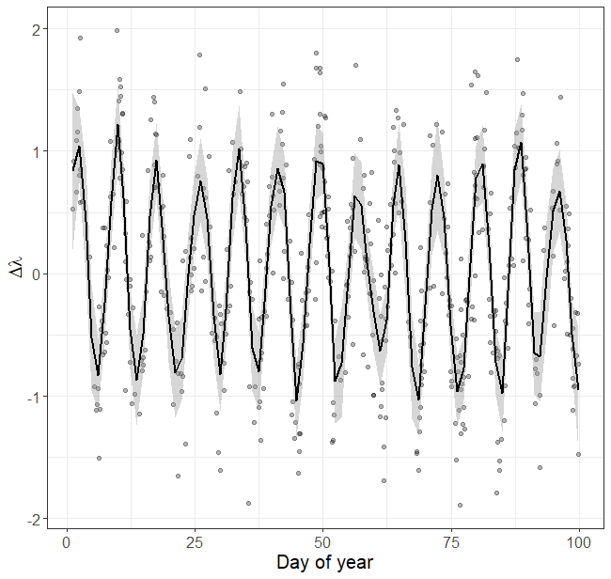
Knowing how to program does not mean you understand the statistics
A common misconception is;
“I can code a model in R, therefore I understand the stats”
Can you copy and paste this code?
Congratulations, you’ve just run a generalised additive model, with growth explained by a function of day of year, allowing a maximum of 100 knots, but effectively using 49.72, for the cubic regression spline basis.

Slide 4
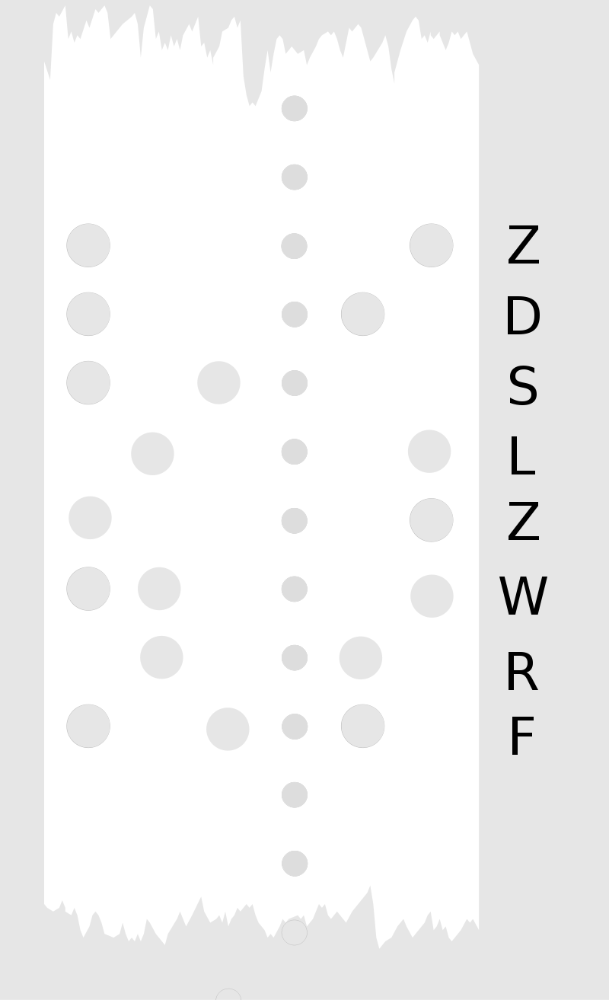
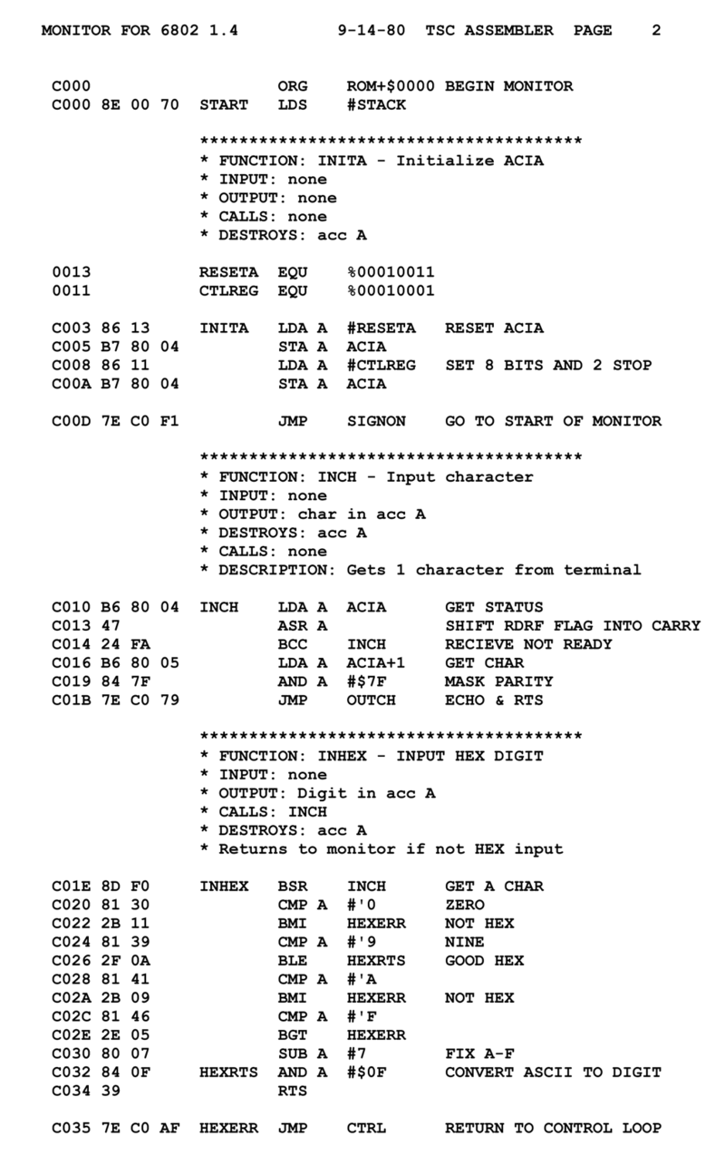
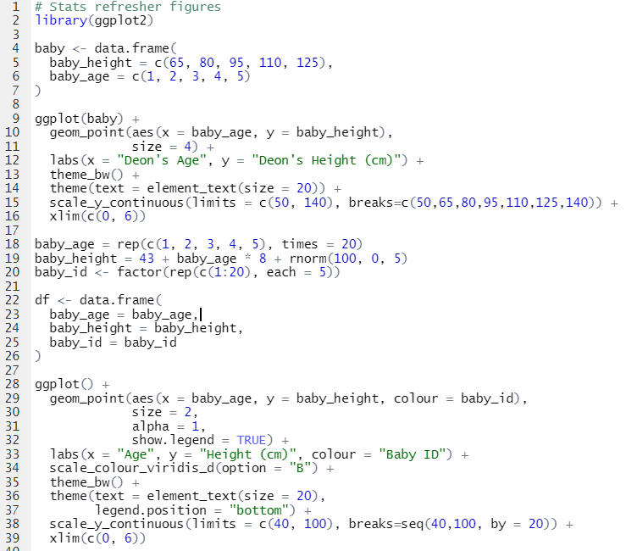
History of programming language
Raw binary code
0001 0110 1011
Low level languages
E.g. Assembly
Still coding in “machine” language
Very early symbolic language
Very difficult to code and debug
High level languages
E.g. R, C++, Python, Java, etc.
Handle conversion of phrases into raw binary
Conversion is called “compiling”
Code is “readable”, using English word

Slide 5

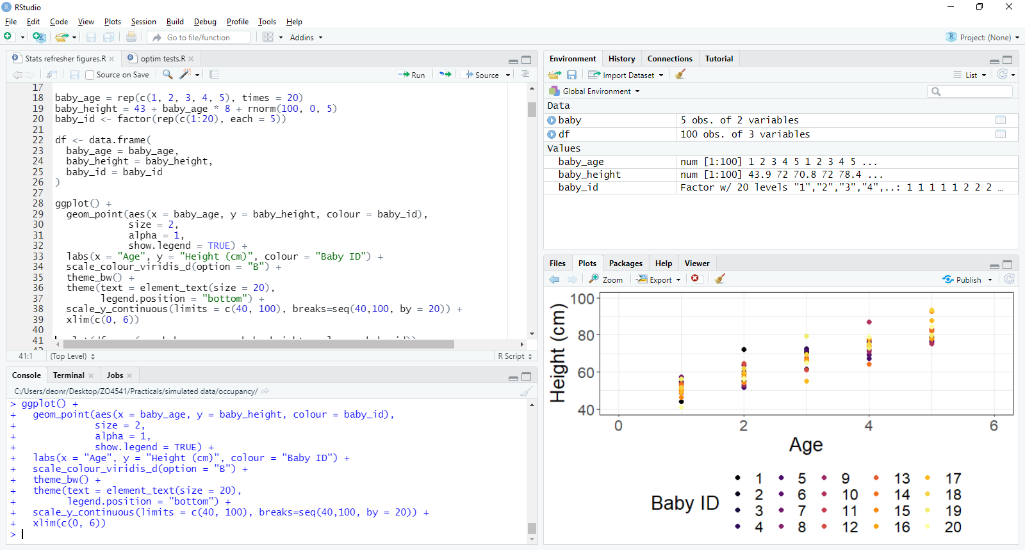
IDE and RStudio
If you so wanted, you could code directly in R via the “console”
Working directly in the console can be fiddly and cause issues
Imagine writing an essay in Word without being able to save
R is the programming language
RStudio is an IDE
Integrated Developer Environment
An IDE is kind of like the Word equivalent for a given programming language

Slide 6
RStudio
To run code, either press Run button, or press Ctrl + Enter (Or Cmd + Enter on Mac)
Objects in environment,
e.g. stored data
The script editor;
e.g. Word for R
Preview area,
e.g. see plots, animations, etc.
The console;
e.g. Word without “save as”

Slide 7
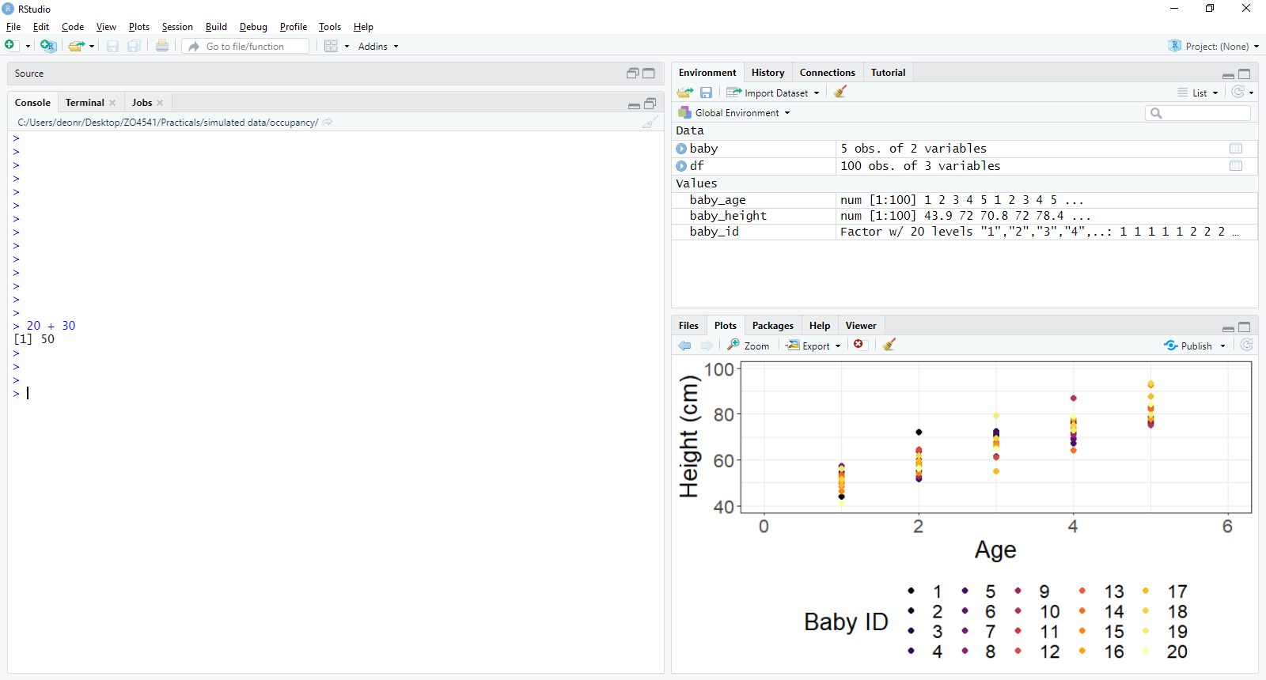
R is a fancy calculator
We can do very simple maths using R
For example, 20 + 30 = ?
In the R console, we can code this as;
20 + 30
The “>” is a prompt, i.e. “I am ready for code”
If we run the code (i.e. hit “Enter”)
R returns [1] 50
[1] means that this is the first value
And in this case, the only value
50 is the solution to 20 + 30

Slide 8
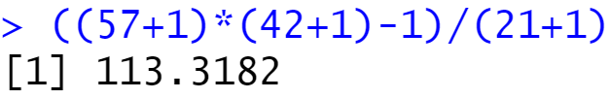
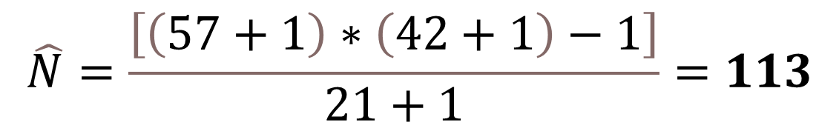
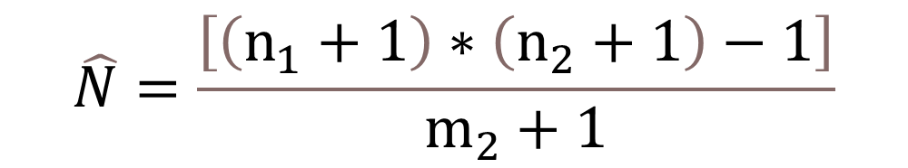
Let’s redo the Chapman Estimator in R
From the very first lecture we did
In R, we can do;
$$\hat{N}=\frac{\left[\left(n_{1}+1\right)∗\left(n_{2}+1\right)−1\right]}{m_{2}+1}$$
$$\hat{N}=\frac{\left[\left(57+1\right)∗\left(42+1\right)−1\right]}{21+1}=113$$

Slide 9
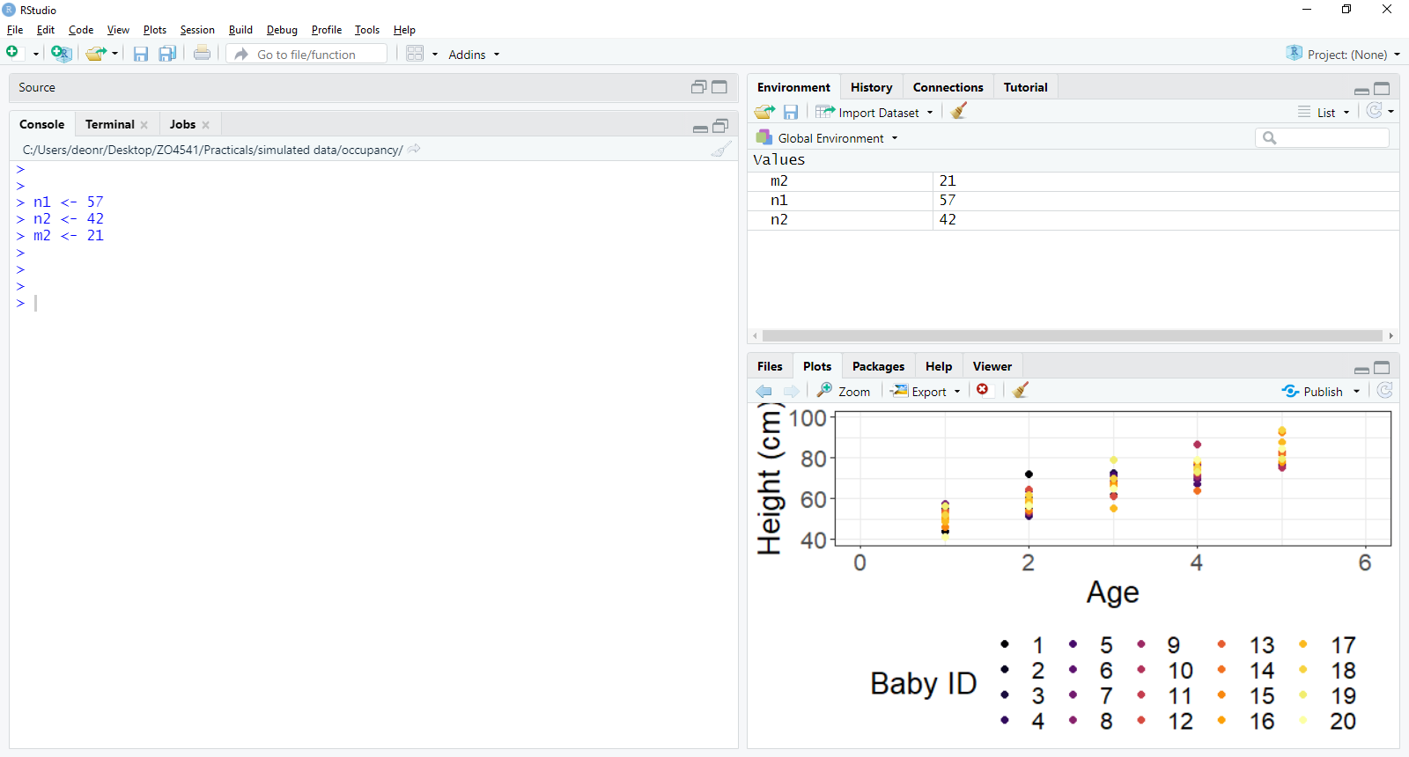
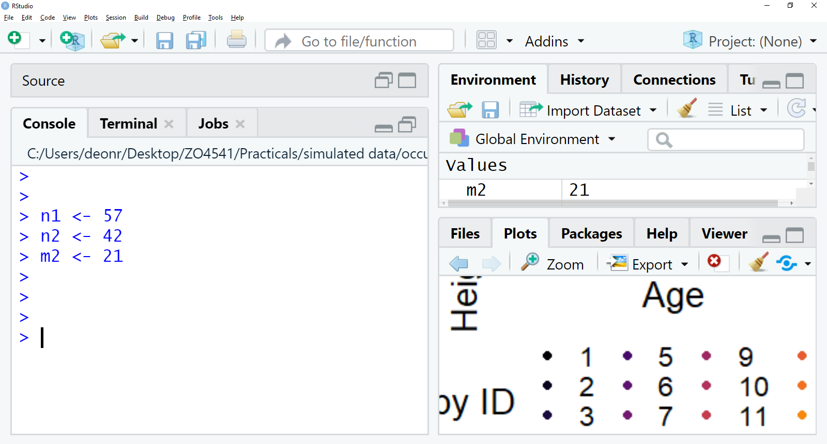
You can store values as objects
Quite often, you can make your life easier by storing values for later use
We store them as an “object” and they will appear in our “Environment”
E.g.

Slide 10
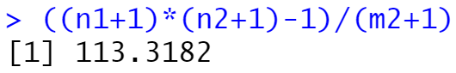
Using stored objects
Let’s rewrite the Chapman estimator using our stored objects (n1, n2 and m2),

Slide 11
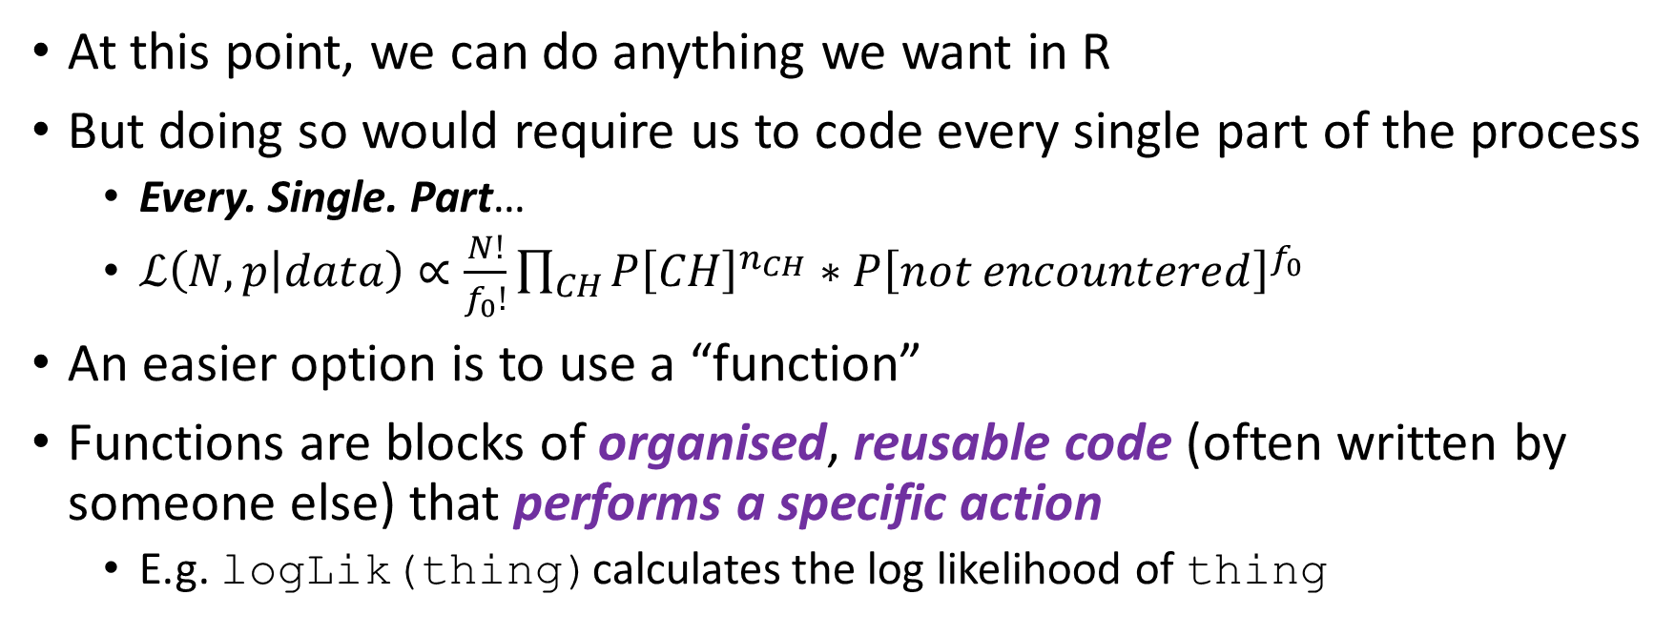
Functions
At this point, we can do anything we want in R
But doing so would require us to code every single part of the process
Every. Single. Part…
$ℒ\left(N,p | data\right)∝\frac{N!}{f_{0}!}\prod_{CH}{P{\left[CH\right]}^{n_{CH}}}∗P{\left[not encountered\right]}^{f_{0}}$
An easier option is to use a “function”
Functions are blocks of organised, reusable code (often written by someone else) that performs a specific action
E.g. logLik(thing)calculates the log likelihood of thing

Slide 12
Anatomy of a function
A function has two main components
a_function(argument1, …)
Multiple arguments are distinguished with “,”
The name of the function we want to use, always follow by ()
The information (or argument[s]) required for a function to work, wrapped by ()

Slide 13
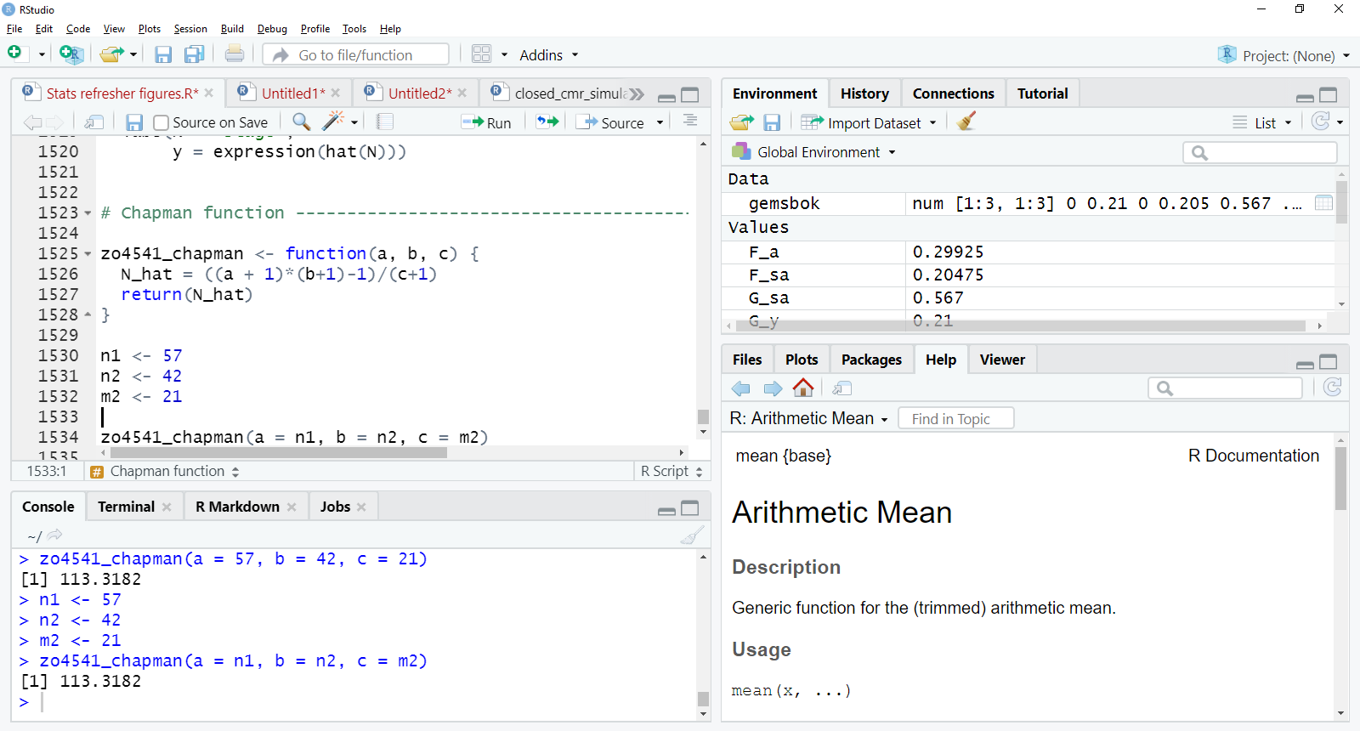
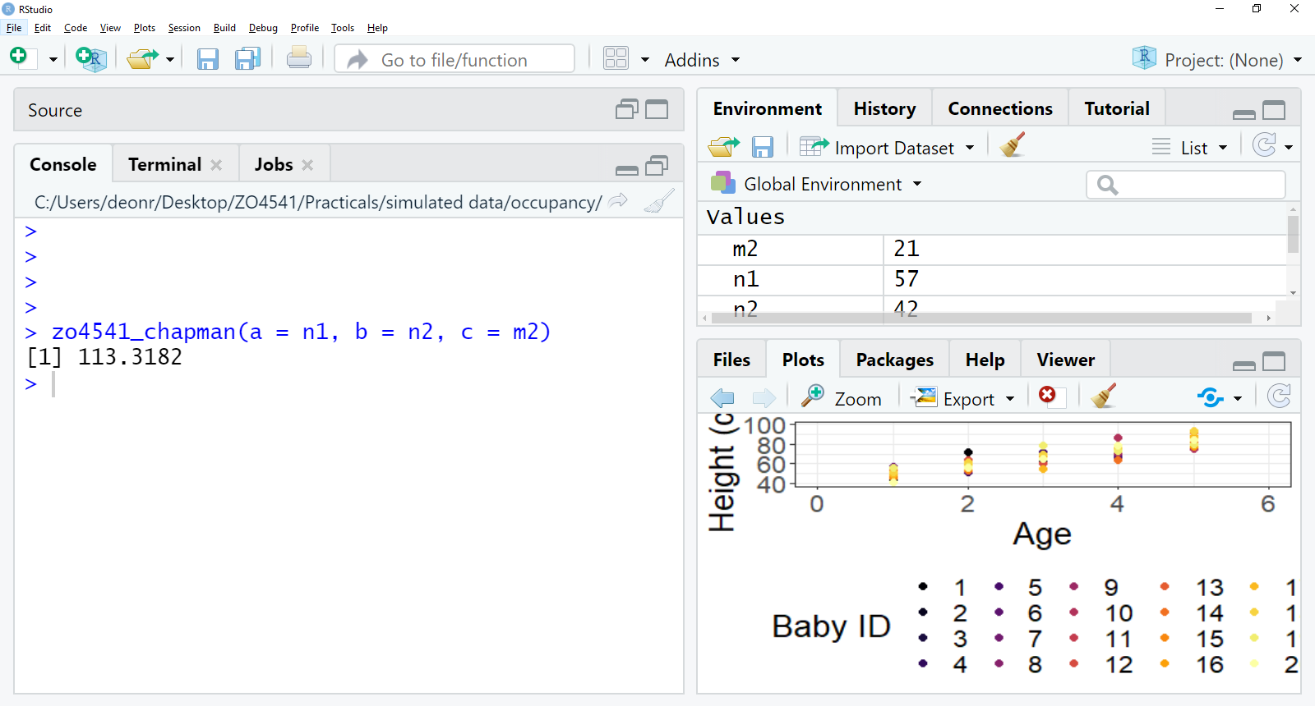
A chapman estimator function
I made a function in R for our chapman estimator
Don’t worry about the code
The arguments required for this function to work are called a, b, and c
a, b and c are just n1, n2 and m2, labelled differently
Because we have this information already stored in our environment, we pass this information on to the function
The name of the function
The information required

Slide 14
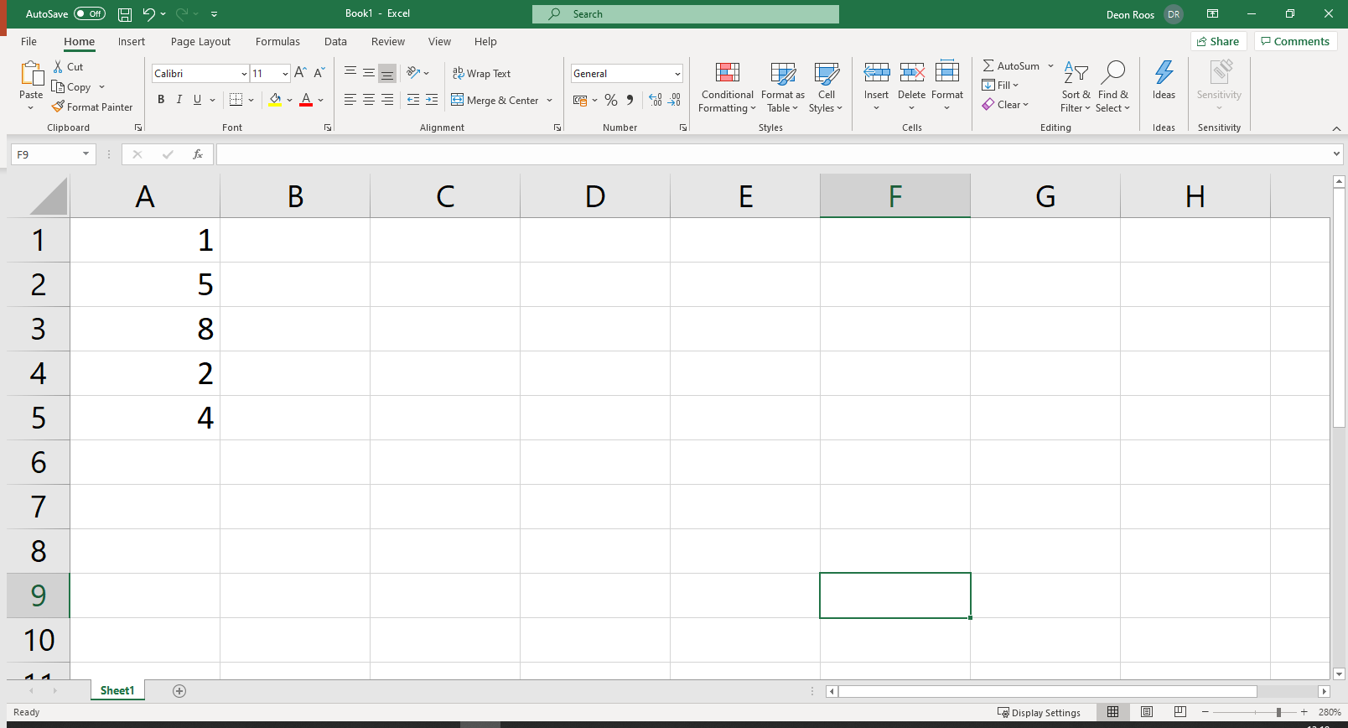
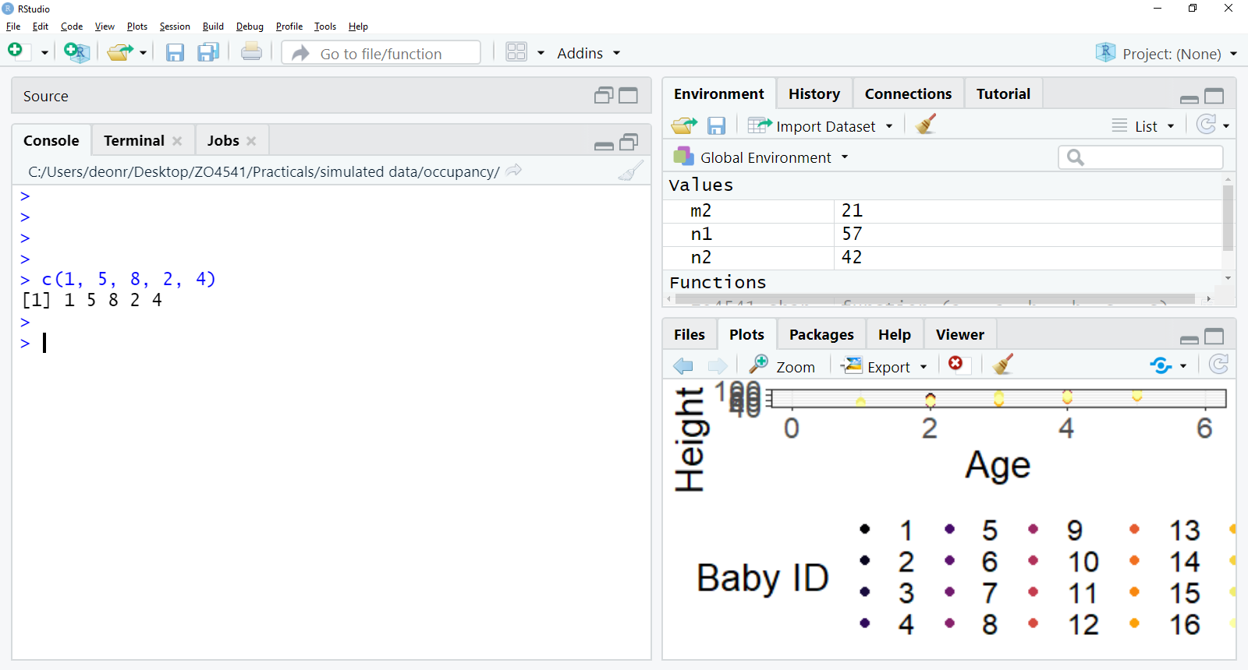
Function examples
Say we had five values (1, 5, 8, 2, 4) which we want stored as a column of data
This is, conceptually, a very trivial task, but to code it by hand is surprisingly complicated
So instead, we can use a function keep the task simple
The function is called concatenate in English, or c() in R
([1] refers to the column)

Slide 15
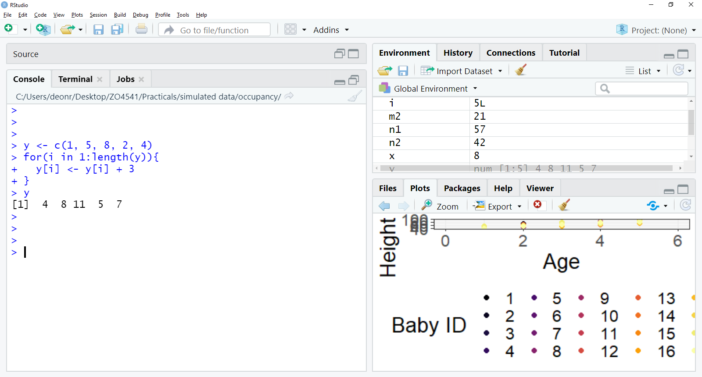
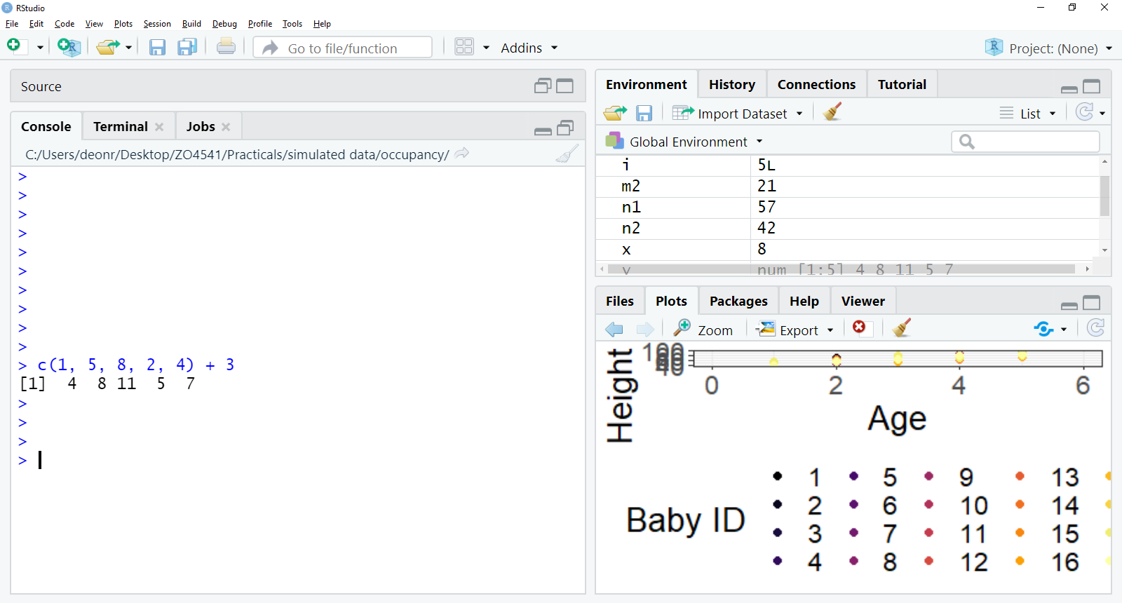
The reason why people started using R
Say we wanted to add 3 to each value in our column of data
In most other languages, this would require some “heavy” coding
Via something called for loops
R is sometimes referred to as a vectorised language
This means that we can use a whole column of data when doing maths/stats
(Nowadays, people use R cause everyone else uses R)

Slide 16
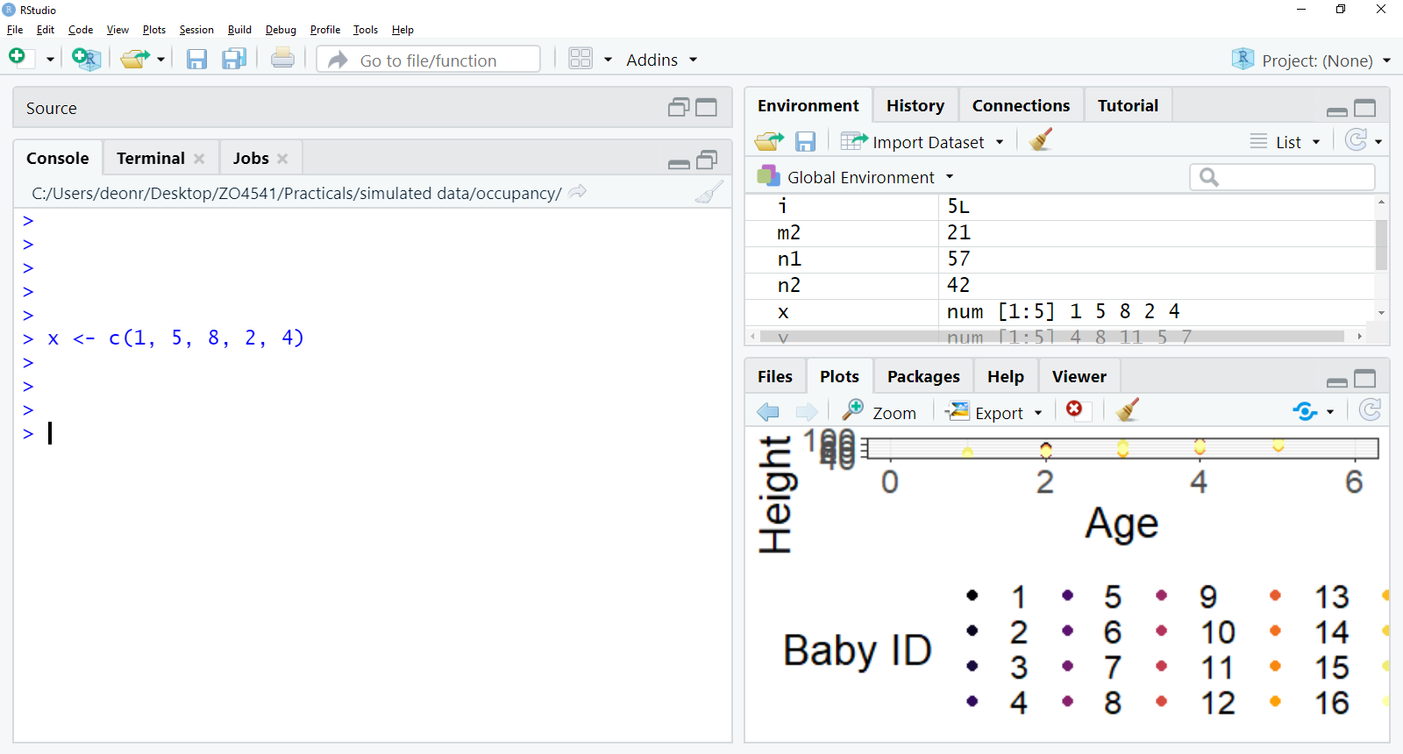
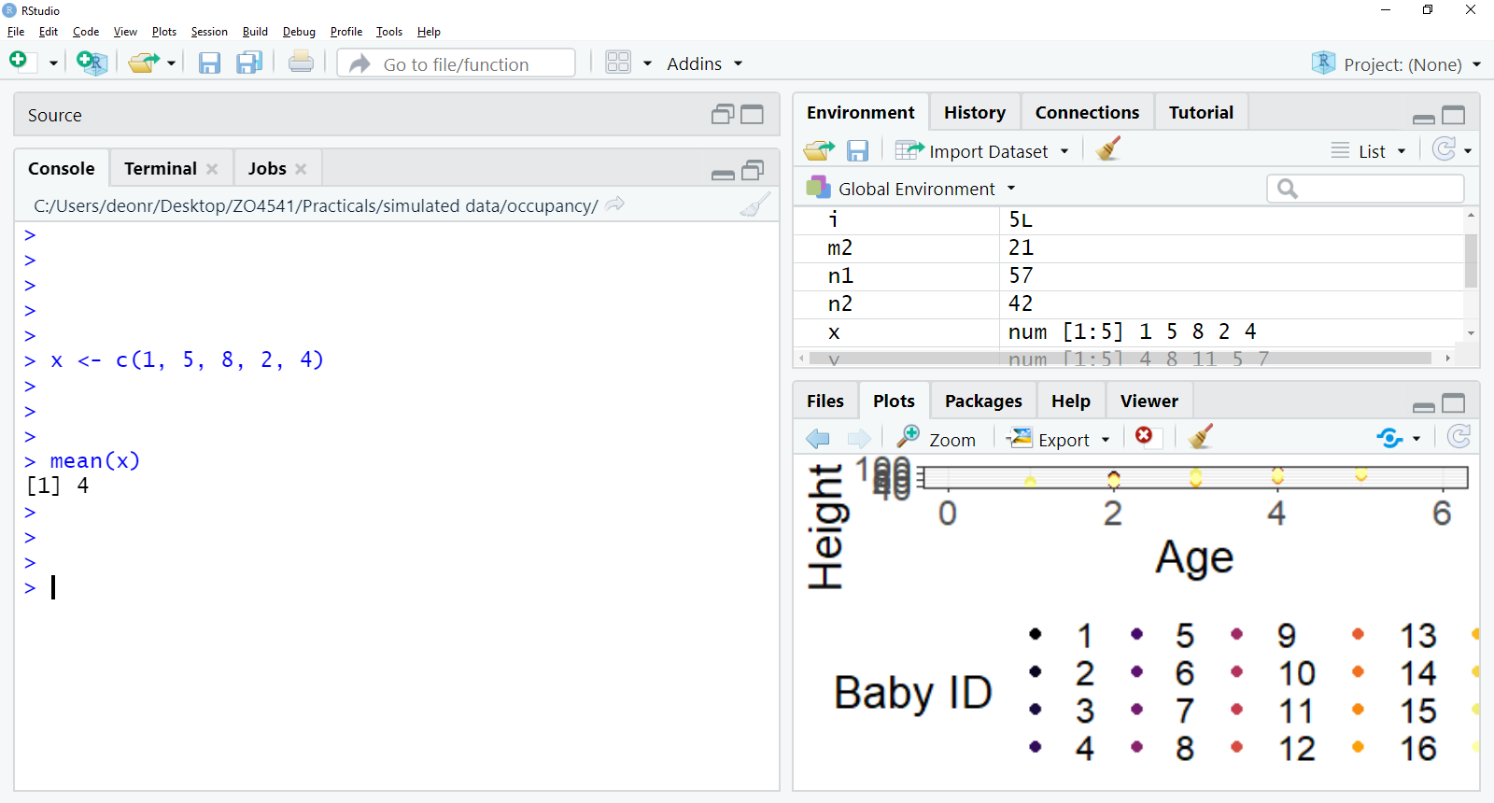
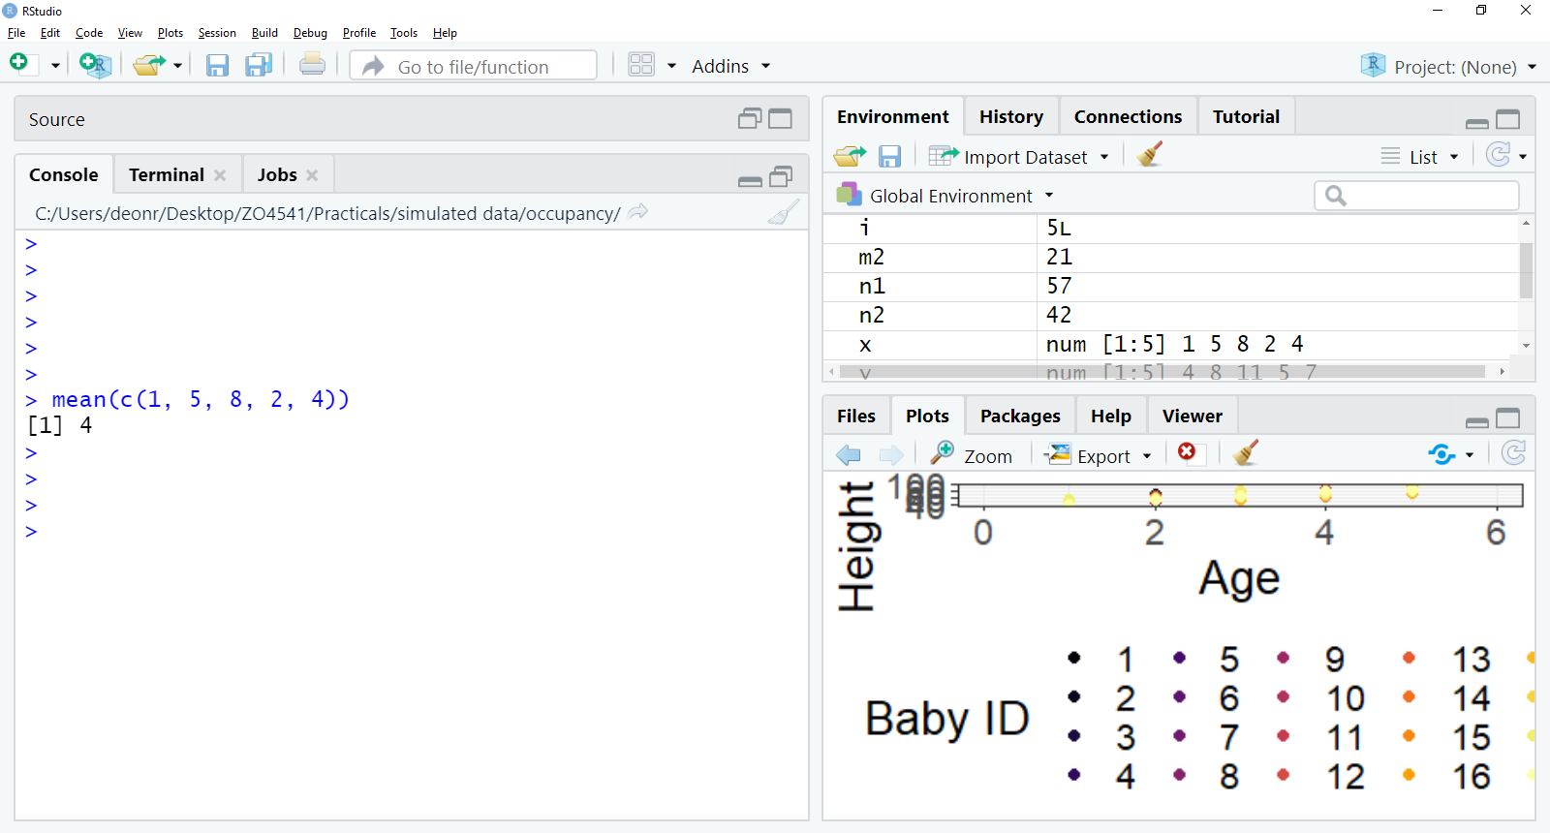
Nesting functions
So far we’ve used one function at a time
What if we wanted to calculate the average value in a column of data?
This is a good approach to use
Storing values at various points
But we could do it in a single line of code
By “nesting” one function within another
Nested functions are “read” from the inner most function, to the outer most function

Slide 17
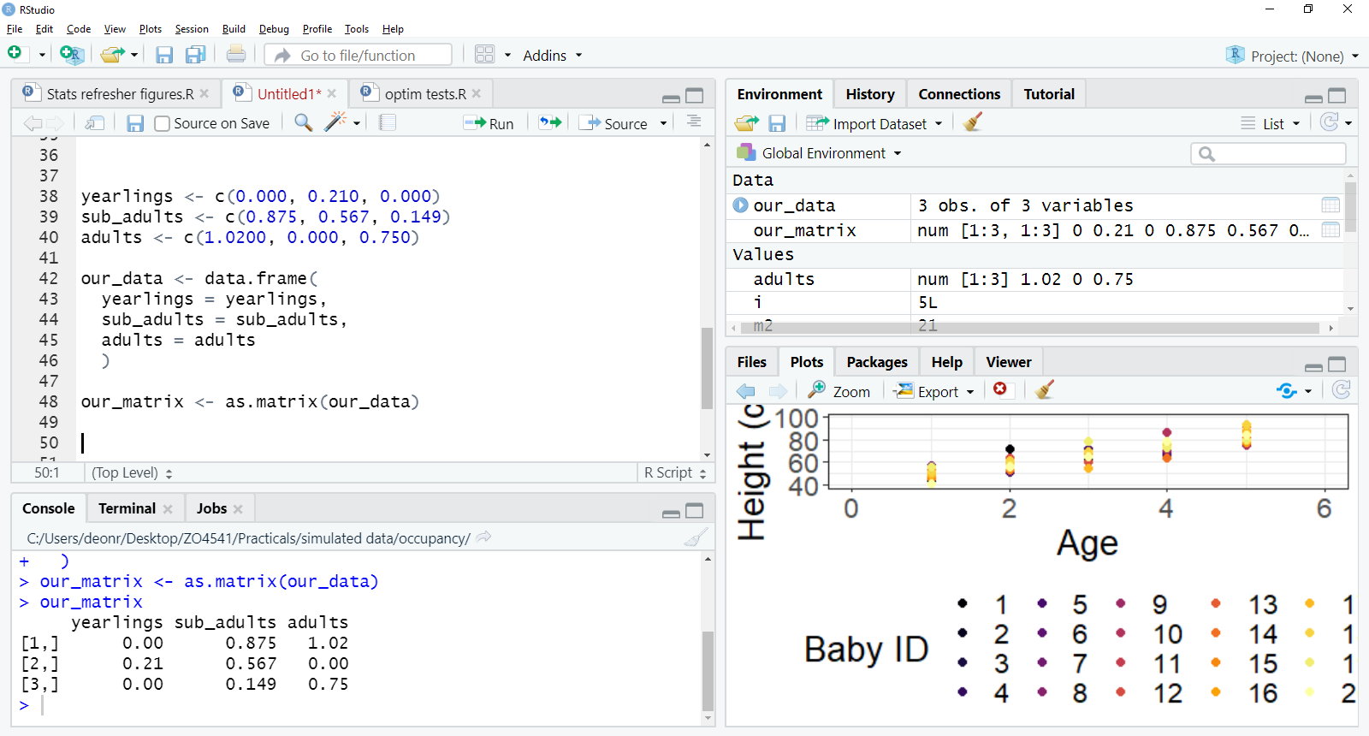
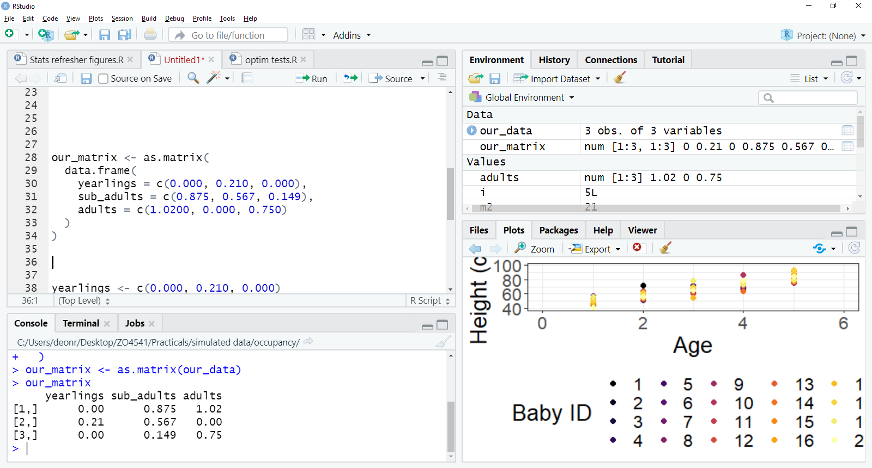
Creating a matrix in R
For the practical, we’ll create a matrix in R
We could do this in separate steps, e.g.
But doing so increases risks of bugs and is a bit “messy”
Lots of redundancy
Objects are created and called multiple times
Copy and paste errors
A better option would be to use nested functions, and do this all in a single line of code

Slide 18
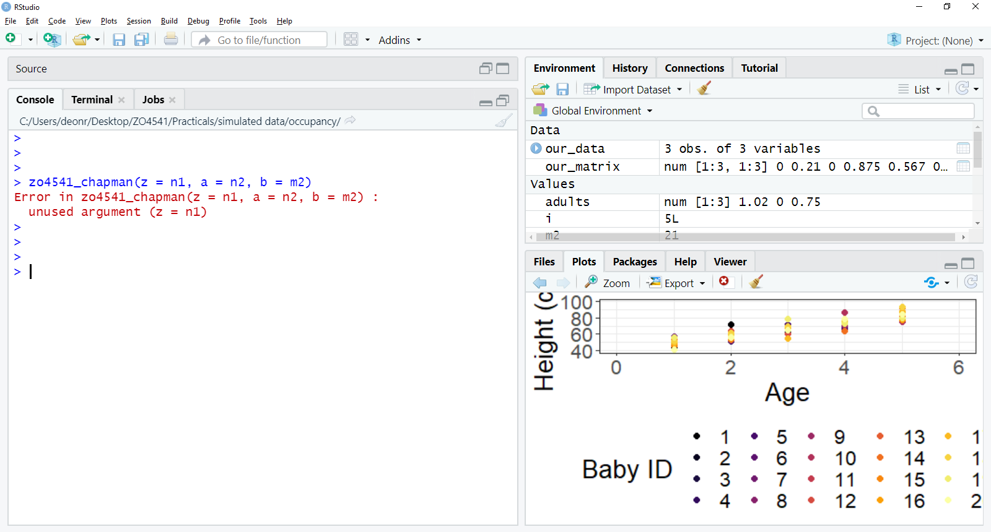
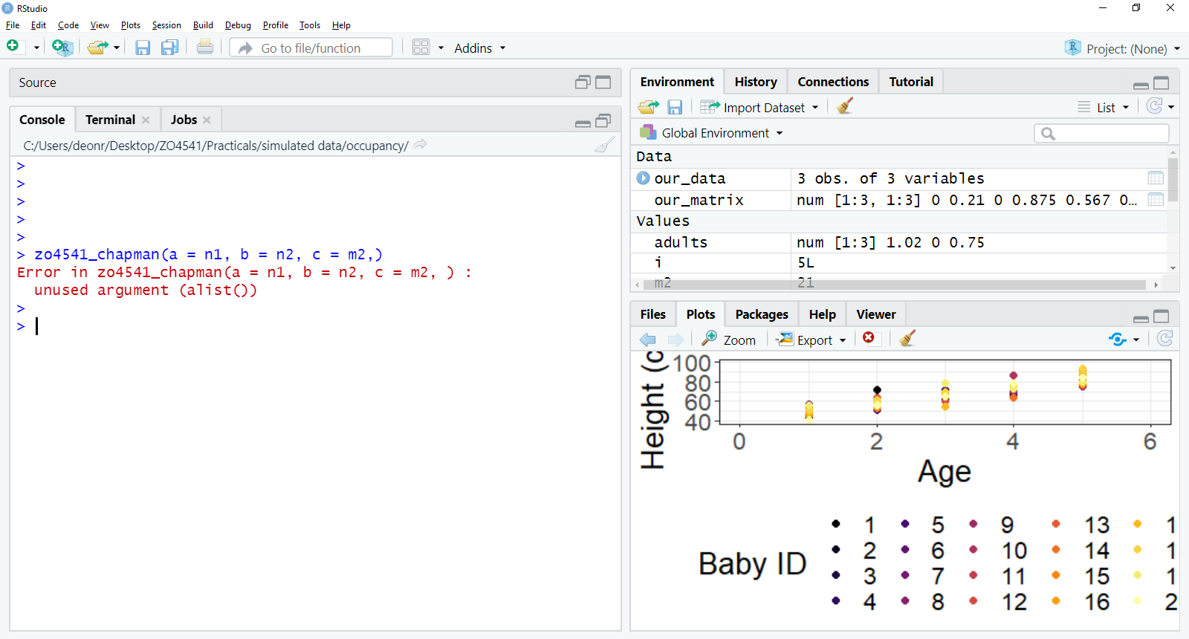
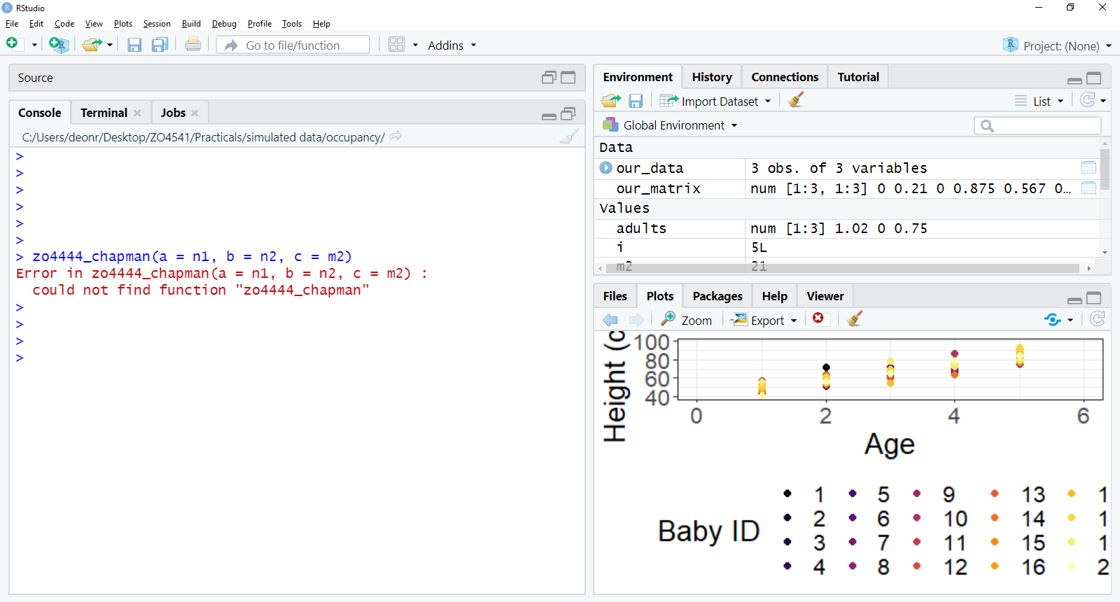
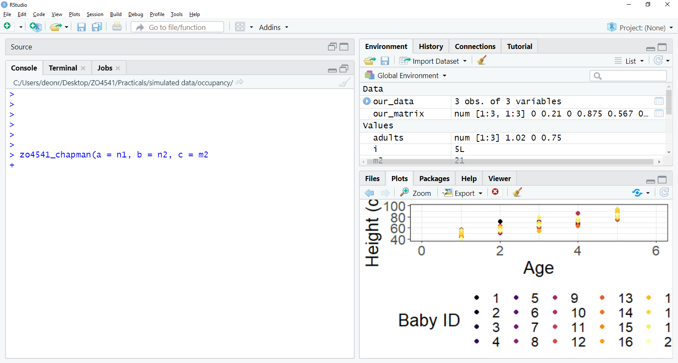
Common R mistakes
Using wrong argument name
E.g., there is no z argument
Typos
E.g., extra commas
E.g. typo in function name
E.g. not closing brackets
If you get a warning you do not understand, paste it into Google!

Slide 19

Getting more functions into R
The base version of R has many functions
But these are general purpose functions
E.g. mean()
In many cases we want to do some niche/specialised analysis, requiring specialised functions
This is the big benefit of R
Open source, so lots of people contribute to the software
To get additional functions, we need to install a “package”
“Package” because it is a package of functions

Slide 20
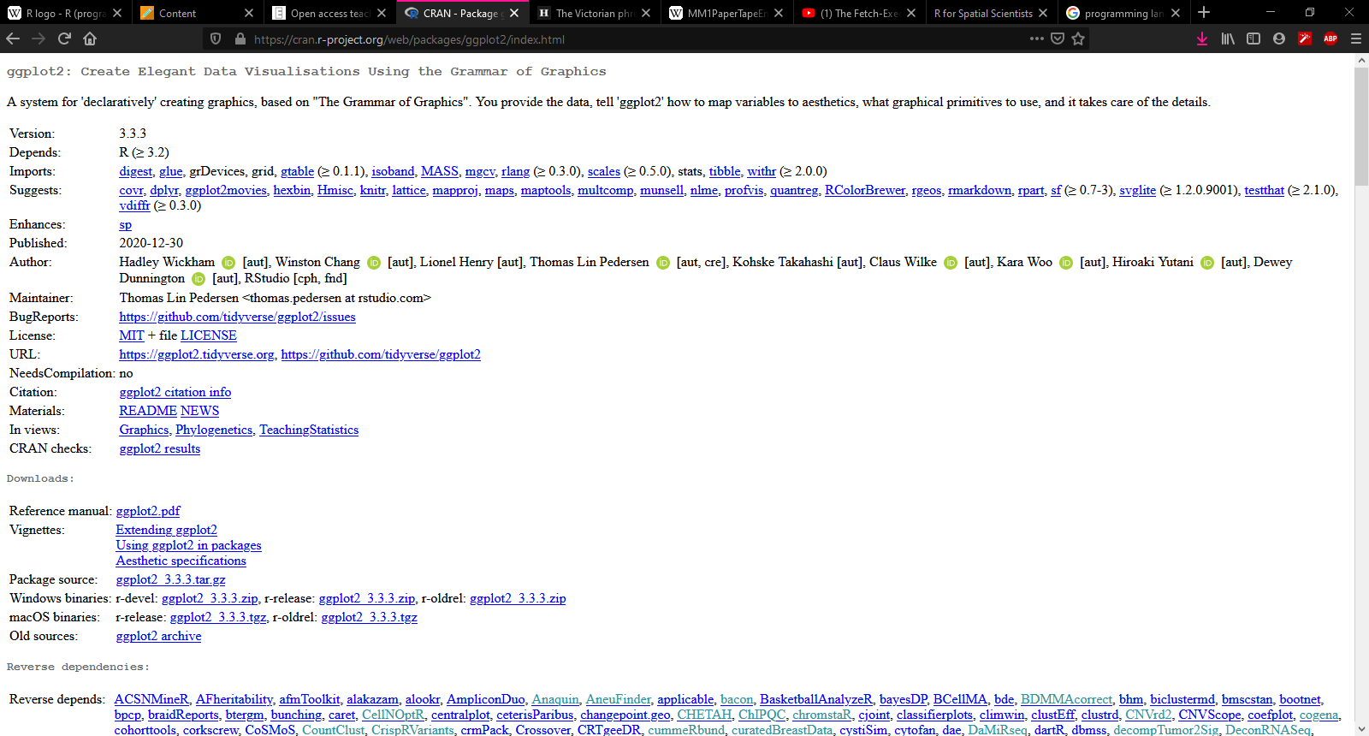
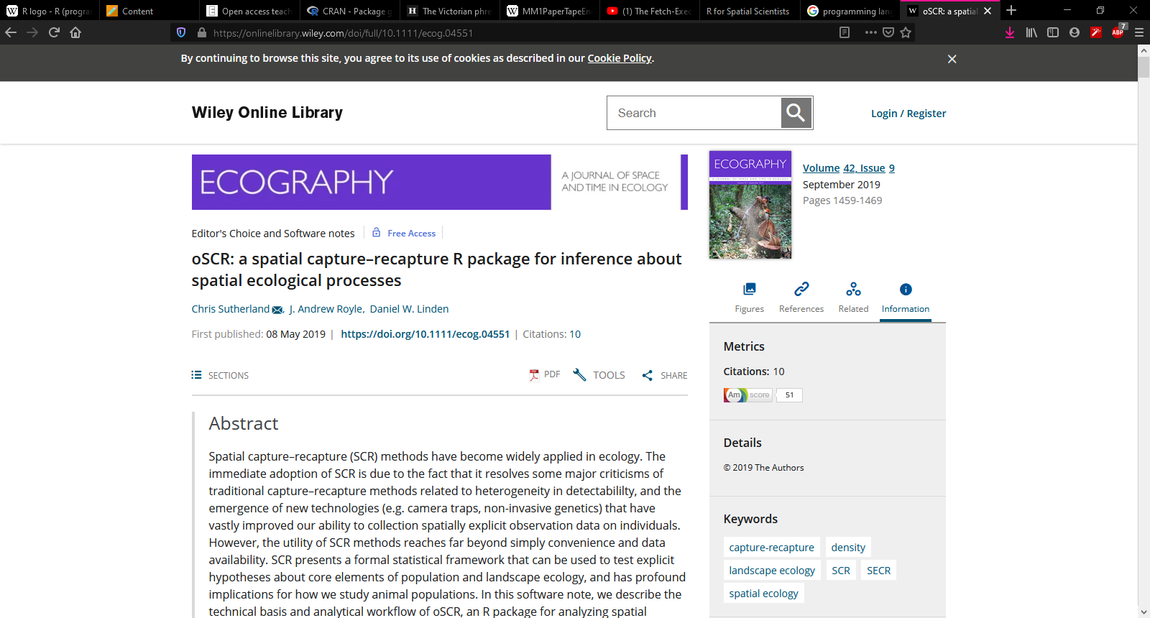
What is a package?
A package is a collection of code, and resulting functions, which you can freely download whenever you please
Stored in an online repository called “CRAN”
Packages are often described in published papers
Especially true for packages which are used for statistical analysis
A major benefit over, e.g., Python

Slide 21
To install a package;
Relatively simple process;
Code the download in R
install.package(“popdemo”)
We use quotes to help R can search for the correct package
One installed, it is on your computer
To actually use it, we need to load it in R
library(popdemo)
We do not need quotes any more because R knows what it is
The function is called library, because we have a “library of packages”
Each time we open R, we will need to reload the package

Slide 22
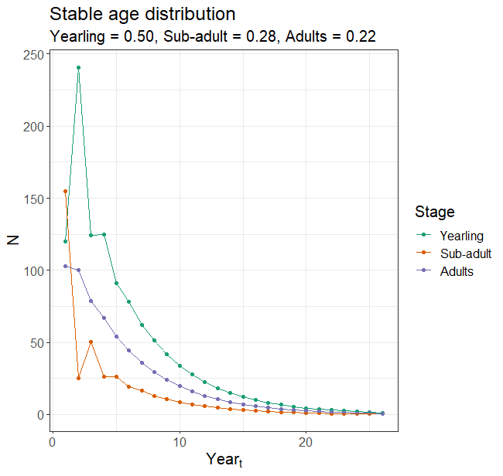
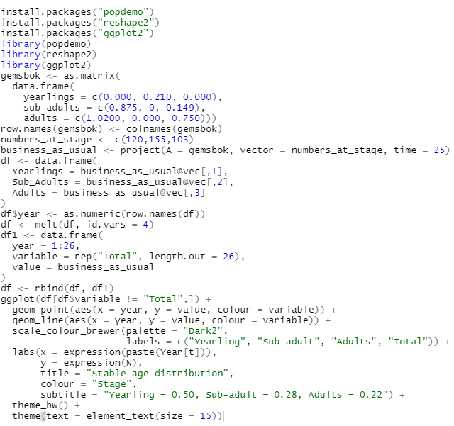
What you can do in R

Slide 23
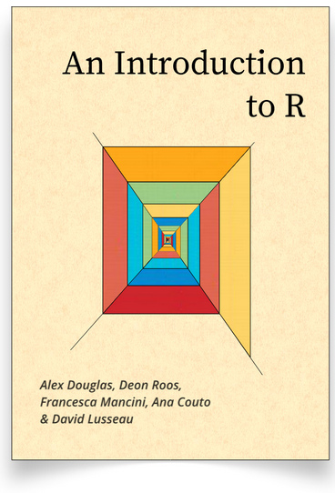
To properly learn how to code in R:
https://intro2r.com

Slide 24
Extra “reading”
https://youtu.be/Z5JC9Ve1sfI
~5 minute video that explains how computers and programming languages communicate with each other
https://youtube.com/playlist?list=PLDcUM9US4XdNM4Edgs7weiyIguLSToZRI
Statistical rethinking lecture series by Richard McElreath
One of the absolute best statistical lectures I have ever seen
If you are planning on doing a PhD watch it!
https://workshops.distancesampling.org/online-course/syllabus/Chapter1/
Lecture series from Distance Sampling developers

